Slide 1
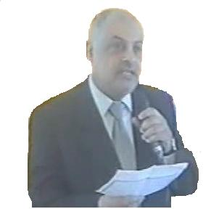
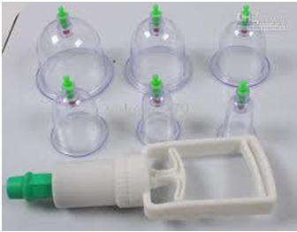
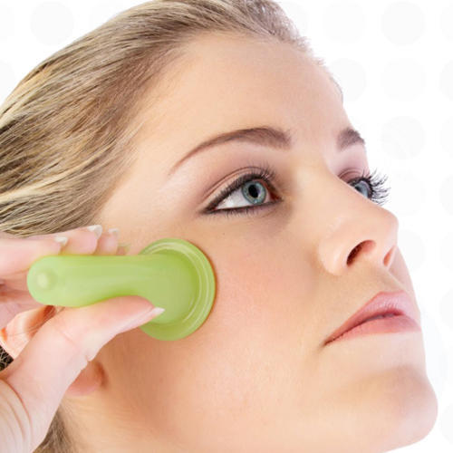
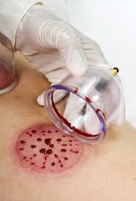
Al-Hijama Cupping Therapy ( 3 Steps Technique = suction,scarification,suction ) For Skin Diseases
Dr Muhammad M Al Hennawy Ob/gyn consultant Egypt

Slide 2
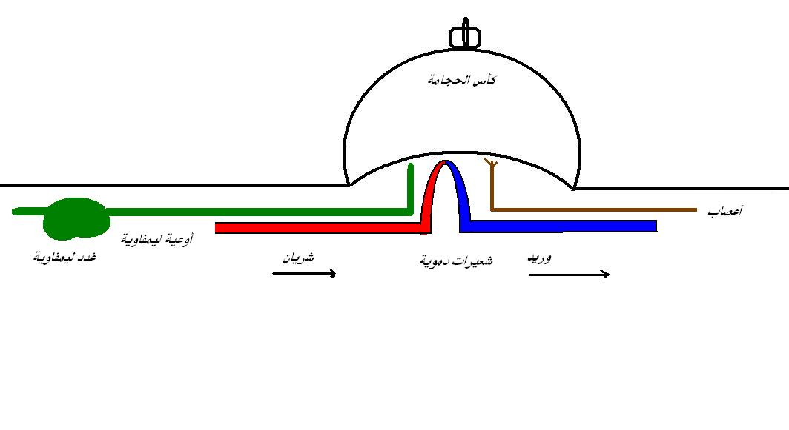
Al-Hijamah الحجــامة
Hijamah is a Sunnah as well as a medical treatment.
The word ‘Hijamah’ is derived from the word Al-Hajm which carries the meaning: to suck, to absorb, or to extract.
It describes a medical treatment whereby ‘dirty’ blood is extracted from the body by a suction cup attached to a lightly incised skin surface.

Slide 3
“For every disease there is a cure so if the medicine comes upon the disease it cures it by the will of Allah, the Most High.” [Saheeh Muslim – 2204]
The Prophet (PBUH) said, “Cupping is the most helpful procedure for human beings to cure themselves.” (Al Bukhari, 5357, and Muslim 1577)
The Prophet (PBUH) also said: “If there is anything good in the medicines with which you treat yourselves, it is in the incision of the Hijama therapist, or a drink of honey or cauterization with fire, But I Do Not Like To Be Cauterized.” [Muslim #2205]
The Prophet (PBUH) said, I did not pass by any group of angels on the night of Al Isra’ (Ascension), except they said to me: “O Muhammad, order your nation to do Cupping”. [Ibn Majah #3477]

Slide 4
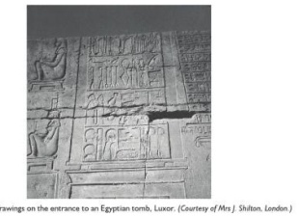
History of Cupping
Cupping therapy is an incredibly ancient and universal practice that spans both East and West. In the primitive shamanistic practices of all the world's indigenous peoples, there were certain shamans who specialized in the sucking out of illness and infirmity from the body. In the East, the Chinese have been practicing the art of cupping for at least three thousand years. Along with Tui Na massage, acupuncture and moxibustion, cupping forms part of the traditional bodywork or physiotherapy system of TCM, or Traditional Chinese Medicine. Cupping is applied to the acupuncture points to relieve the stagnation of Qi and blood, both locally and in the organ(s) activated by the point. In the West, cupping therapy had its birth in Egypt. The Ebers Papyrus, written around 1550 B.C.E., states that bleeding by wet cupping removes foreign matter from the body. In cupping, the ancient Egyptians saw the remedy for just about every disorder. The ancient Egyptians passed the art of cupping on to the ancient Greeks. Both Hippocrates and Galen were staunch advocates and users of cupping therapy. Galen once condemned Erasistratus, a noted physician in Alexandria, for not using cupping. Herodotus, a famous Greek historian and physician, wrote, in 413 B.C
From the ancient Greeks and Romans, through the Alexandrians and Byzantines, cupping therapy was passed on to the Muslim Arabs and Persians. The Prophet Mohammed even sanctioned the use of cupping. Cupping is now an important and popular therapeutic modality of Unani Medicine. In the West, cupping remained an important part of medicine and therapy, both conventional, alternative, and folk-based, until the early 20th century. The surgeon Charles Kennedy wrote, in 1826:

Slide 5
Types Of Alhijamah
Dry cupping it is also known as Single (S) technique as it involves onely one step suction technique
Tradidional Wet cupping - Chinese (traditional) WCT is also known as double (S-S) technique as it involves two steps scarification of the intact skin (not preceded by suction) and suction using sucking cups applied to the skin surface
Alhijamah ( prophitic medicine ) (WCT of prophetic medicine)is also known as triple (S-S-S) technique as it involves three steps: 1st suction step using sucking cups applied to the intact skin to create skin upliftings, scarification of the skin uplifting (shartatmihjam) and a 2nd suction step i.e. triple S technique.

Slide 6
Recommended Times for Cupping
Prophylactic Hijamah Some less reliable narrations also recommend certain days of the week for cupping while warning against others. ,
the lunar month the 17th, 19th and 21st have been mentioned in some Hadith.
Curative Hijamah, as the need may arise, cupping as a form of medical treatment may be performed at any time according to the condition or urgency.

Slide 7
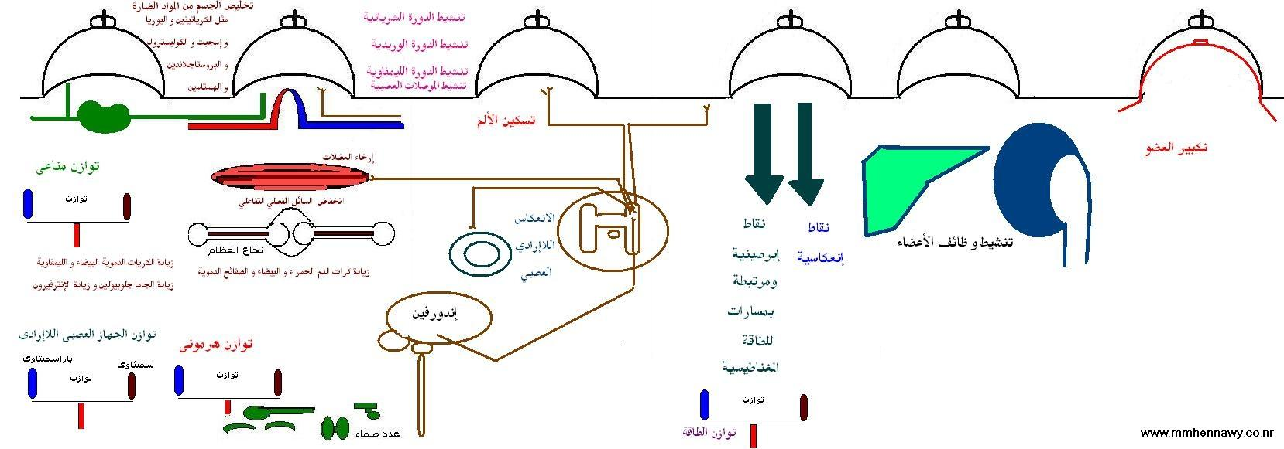
Mechanism of action
Al-hijamah is a minor surgical excretory therapeutic procedure than can clear both the interstitial spaces and blood partially from noxious substances causing the disease etiology or resulting during disease pathogenesis. This occurs through making use of the skin histological structure where the fenestrated skin capillaries may act as filters upon application of suction pressure produced inside the sucking cups during Al-hijamah . This may facilitate regaining physiological homeostasis and recovery to variable extents depending on the degree of clearance of noxious substances
It corrects imbalance of energy at the specific points of the diseases on the skin, same like acupuncture
Stimulation of nerve endings(reflexology)
Improvement of peripheral, collateral and lymphatic circulations.
Getting rid of waste products, oxidized materials and free radicals from these points.

Slide 8
Contraindications
Al-Hijamah should not be performed on
open wounds or
around skin ulcers.
It is contraindicated on irritated skin or
over allergic skin or
where any skin lesions are present.
It should also be avoided in elderly people with thin, delicate skin.
If the patient has a bleeding disorder Al-Hijamah should not be done.
It is also unadvisable to perform Al-Hijamah wherever there are great vessels, and
it is also not beneficial if the patient has serious heart disease

Slide 9
What diseases cannot be treated Cupping Therapy ?
Diseases that cannot be treated by Cupping Therapy include- Congenital (present at birth) and genetic diseases like down syndrome, cerebral palsy, cleft lip, hole-in-heart, congenital dislocation of the hip.- Trauma and accidents for example broken bones and joints, open wound, torn muscles, tissue and organ damage, internal bleeding, and excessive bleeding. However Cupping Therapy can promote quicker recovery or healing of these conditions due to improved blood circulation.

Slide 10
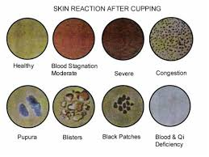
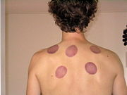
The drawbacks of Cupping Therapy as a treatment
Lack of good quality evidence for efficacy
Vasovagal symptoms (dizziness, etc.)
Insertion site infection (this is considered rare, as needles are sterile and the use of disposable needles has become the norm)
Red or purplish circular marks may appear on the skin for a few days

Slide 11
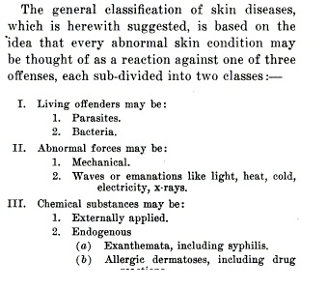
Classification Of Skin Diseases

Slide 12
What skin conditions is cupping therapy used to treat?
Cupping therapy has been used to treat an extensive list of skin conditions, including:
The symptom, itch
Atopic dermatitis
Psoriasis
Urticaria
Acne
Postherpetic neuralgia
Others

Slide 13
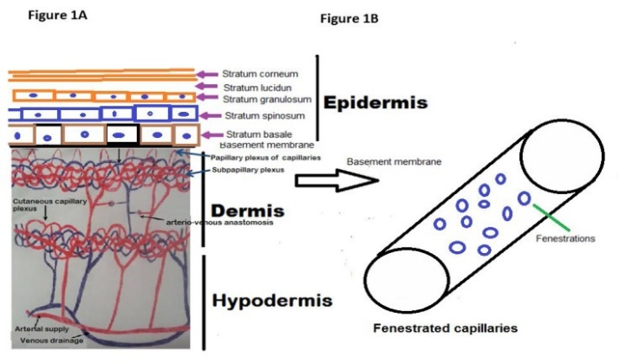
Histologically, ultrastructure of the skin
Skin is formed of three layers: epidermis, dermis and hypodermis
Epidermis is the outermost superficial layer that contains no blood capillaries. of non-viable cells, the keratinized epithelium layer that constitutes the skin barrier (having an average thickness of 10–20 μm) Underlying the stratum corneum is the viable epidermis (50–100 μm thick), that is responsible for the regeneration of the stratum corneum
The dermis (1–2 mm thick) is the second cell layer of the skin that is directly adjacent to the epidermis and provides the mechanical support for the skin. The fenestrated skin capillaries lie at the dermo-epidermal junction
Those superficial fenestrated capillary networks are suitable for the function of pressure-dependent filtration upon application of negative suction pressure as that done during Al-hijamah.
Practically, when performing Al-hijamah, skin scarifications (small superficial incisions, shartatmihjam in Arabic) done during Al-hijamah should be so superficial (about 0.1 mm in depth) just to open the skin barrier and reach the superficial fenestrated dermal capillaries. No need to scarify the skin deeply during Al-hijamah in order not to damage the fenestrated dermal capillaries

Slide 14
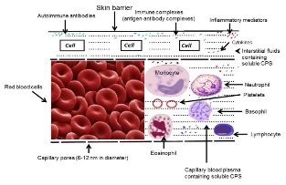
Causative pathological substances (CPS) of diseases are present in serum and interstitial fluids
It is a minor surgical excretory procedure related scientifically to the principles of renal glomerular filtration and abscess evacuation, where a pressure-dependent excretion of causative pathological substances (CPS) occurs. CPS include disease-causing substances and disease-related substances (that result during disease pathogenesis
. Reported CPS include autoantibodies, immune complexes, soluble interleukin-2 receptors, inflammatory mediators, certain cytokines, prostaglandins, toxic cellular products and rheumatoid factor, malondialdehyde, interleukin 6, prostaglandin PGE- 2

Slide 15
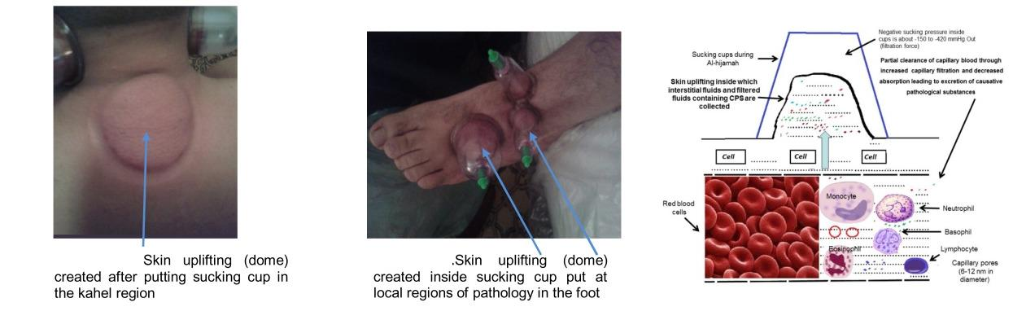
First step in Al-hijamah using Suction cups
Negative pressure applied to skin surface causes local collection of filtered and interstitial fluids containing CPS at skin upliftings inside cups –
In reactive hyperemia, vascular compression causes a decrease in the blood supply to the skin for few minutes resulting in accumulation of vasodilator metabolites. As soon as vascular compression is removed, blood flow to the skin dramatically increases, which is called hyperemia. This brings more blood to the skin circulation and enhances the clearance of blood from CPS

Slide 16
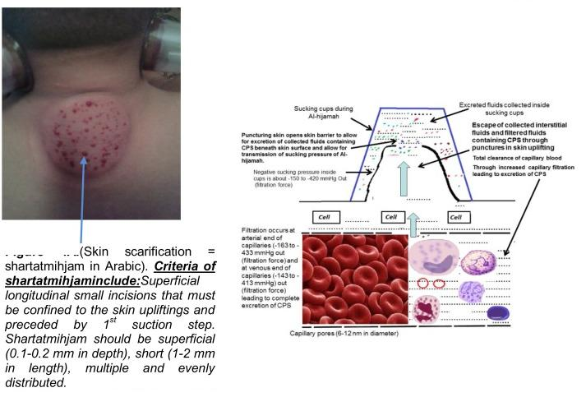
Second step in Al-hijamah scarification of the skin uplifting (shartatmihjam)
Scarifying skin upliftings followed by cupping causes a pressure gradient and a traction force across the skin and capillaries to excrete collected fluids with CPS and cause bleeding at puncture sites

Slide 17
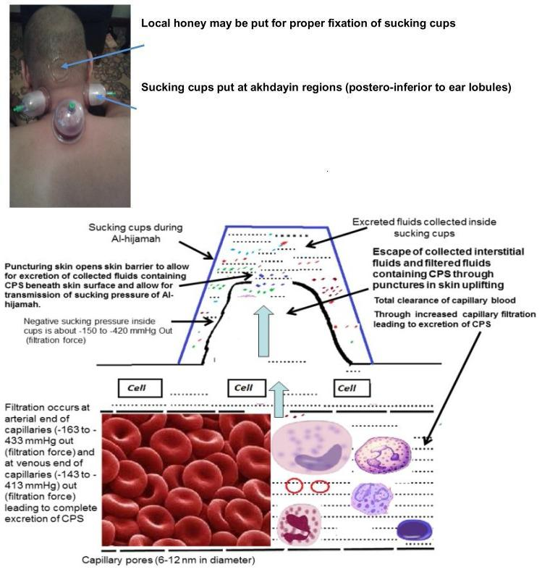
Third step in Al-hijamah is ^{2nd} suction using sucking cups
suction pressure, phenomenon of reactive hyperemia, nitric oxide production and skin scarifications (openings in skin barrier) in enhancing natural excretory skin functions, improving lymphatic and capillary circulations and restoring homeostasis

Slide 18
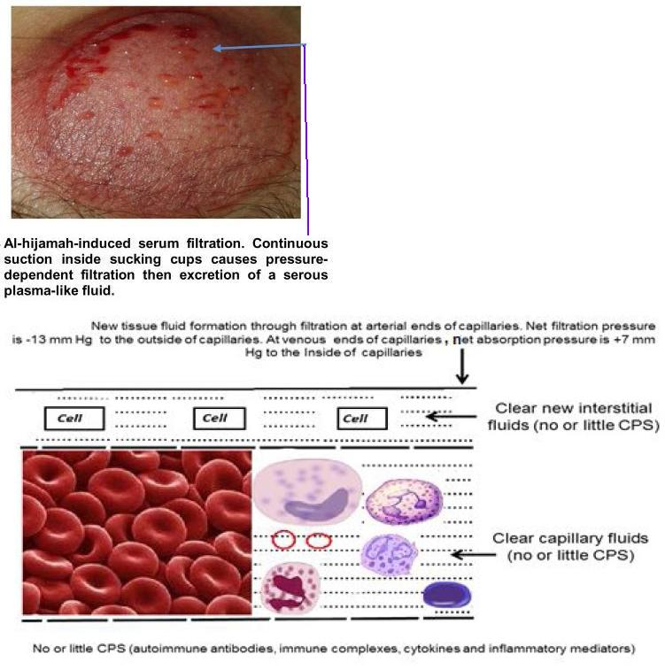
Restoration of physiology and homeostasis.
This occurs after pressure-dependent excretion of CPS of diseases during Al-hijamah
benefits of WCT is related to the amount of excreted CPS not the amount of letted blood

Slide 19
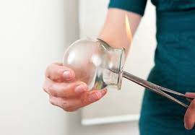
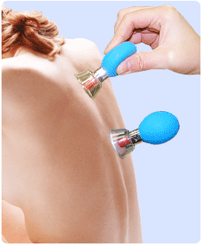
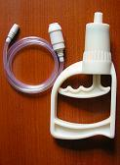
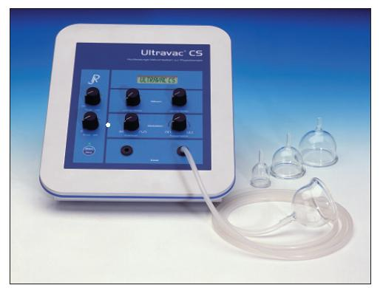
Method of Dry Cupping
A partial vacuum is created in the cup by use fire to consume the air within it. But more recently, squeezable cups with a rubber top, or cups drained by suction pumps are also used
The skin and underlying tissue swells and becomes warm, and gets sucked into the cup
This produces blood congestion at the site and stimulates circulation
After a prescribed period of time the cup is gently removed
No blood is removed from the body

Slide 20
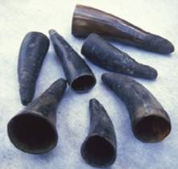
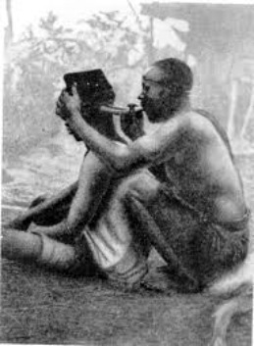
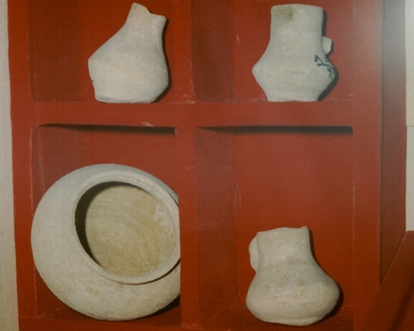
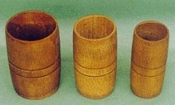
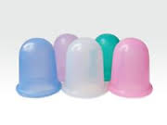
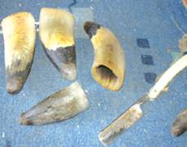
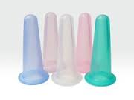
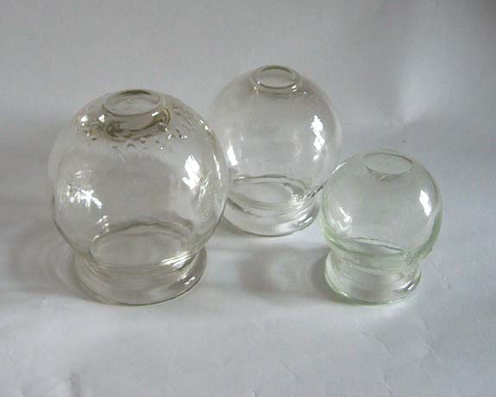
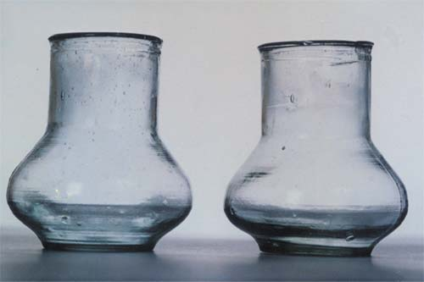
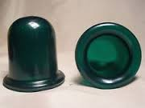
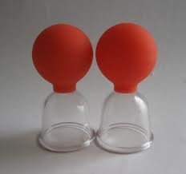
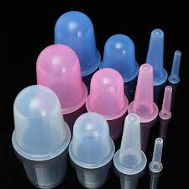
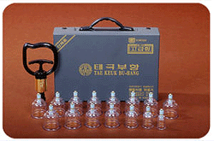
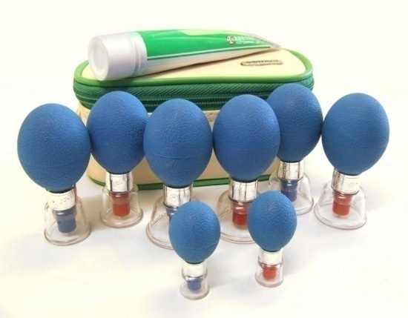
Different Types of Cupping Sets

Slide 21
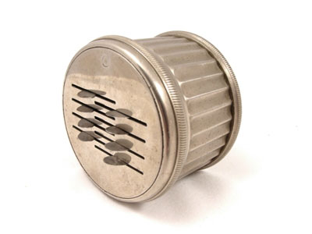
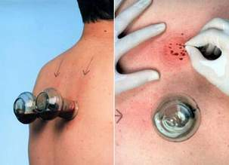
Method of Wet Cupping
Dry cupping is first performed
Small cuts are made in the cupped area and then the cup is replaced on the skin. The skin will be drawn into the cup and blood is sucked out of the area.
When done properly, on an area that has septic blood, the blood drawn will be dark. The process is repeated until the blood turns red. Then the cupping should be stopped.
The area should be cleaned and bandaged as necessary

Slide 22
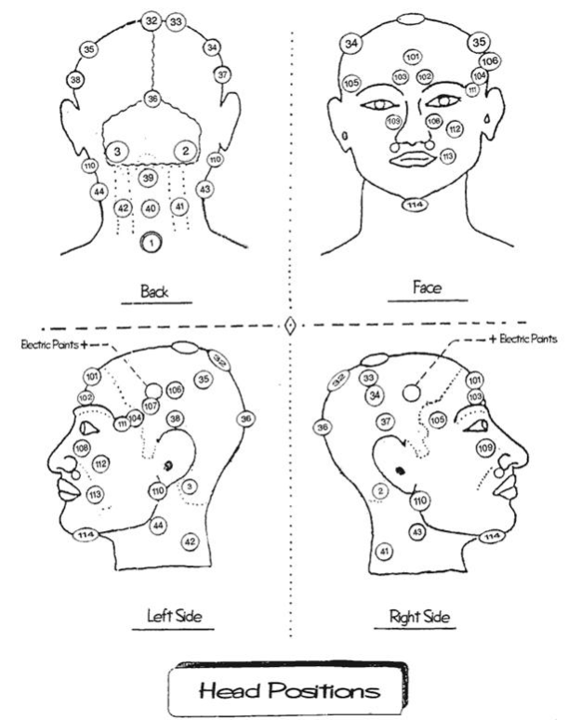
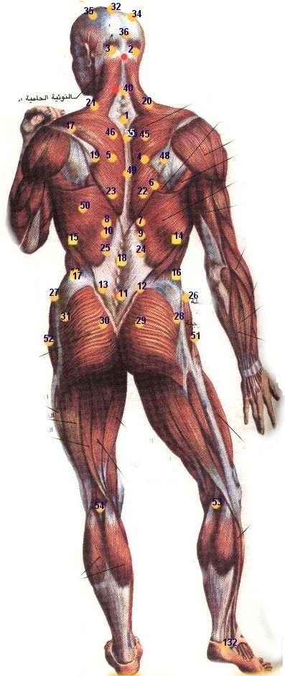
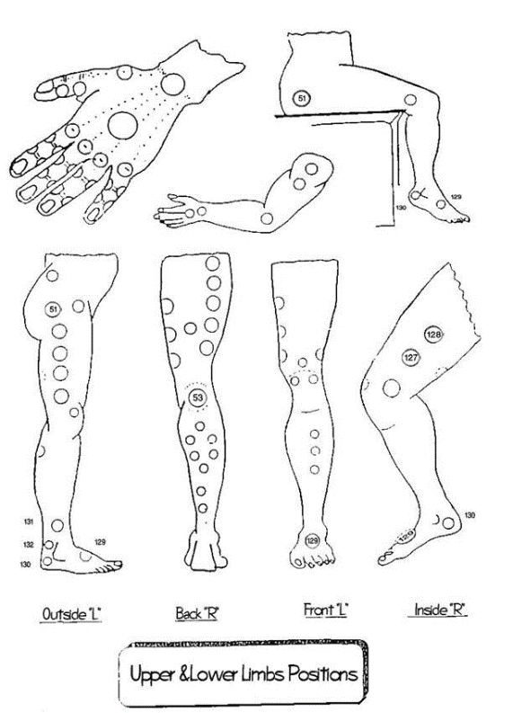
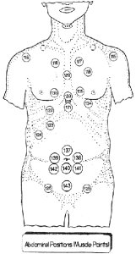
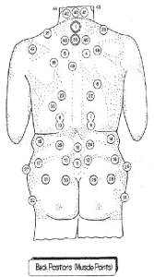
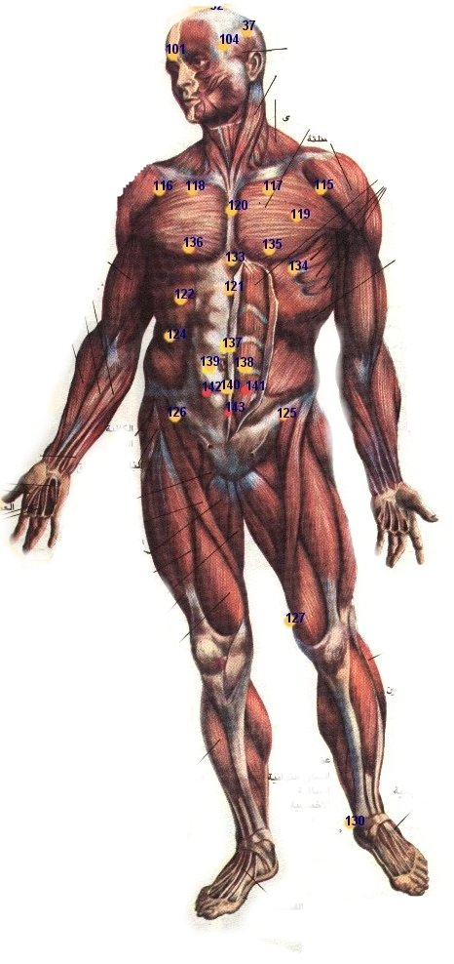
Location for Cupping

Slide 23
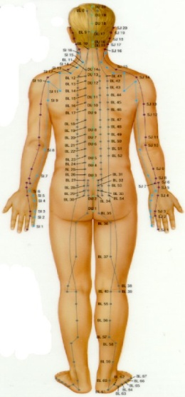
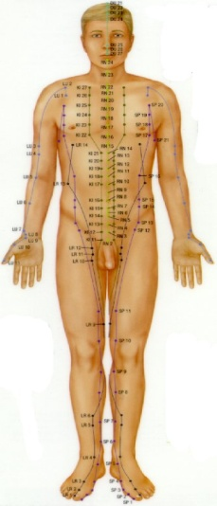
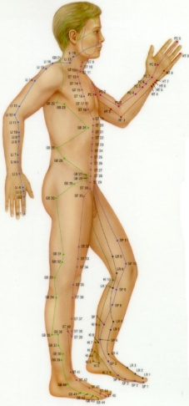
Acupoint
They are located on the twelve organ meridians and on two of the extraordinary vessels.
They are areas of potential imbalance, where Qi, which circulates in the meridians, is most likely to become obstructed.
Western research has shown that approximately 85% of the classical acupoints have a higher electro-magnetic resistance than the immediate surrounding area.
This implies that they are areas where electro-magnetic current, our "information highway", is most likely to be disrupted.
The UN (United Nations) has standardized the names of the classical acupoints. They are named for the organ meridian they are on, and the order in which they fall. Besides the classical acupoints, there are hundreds of "extra points", of which approximately 20 are used with frequency

Slide 24
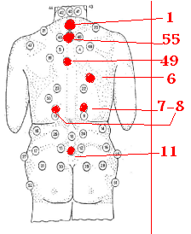
Alhijamah technique was adopted for the treatment of patients
The number of cupping sessions ranged from 4-6 sessions,
with 2-4 weeks interval between sessions,
according to the clinical response.
Cups were applied at the following points
Point (1): on the 7th cervical vertebra.
Point (55): below point 1 by about 3 cm.
Point (49): on the 5th thoracic vertebra.
Point (6): at the lower end of the vertebral border of the scapula on the right side.
Points (7 &8 ): on both sides of the vertebral column at the level of T11 vertebra.
Point (11): on the 5th lumbar vertebra.

Slide 25
in case of eczema,
the suction is applied on points on the body like near the navel, below the kneecap, just above the ankle or on the neck, at the top end of the spinal cord.
Acne
is cured by using cupping on the affected area and sometimes, also nicking the skin to remove the breakout causing pathogens.

Slide 26
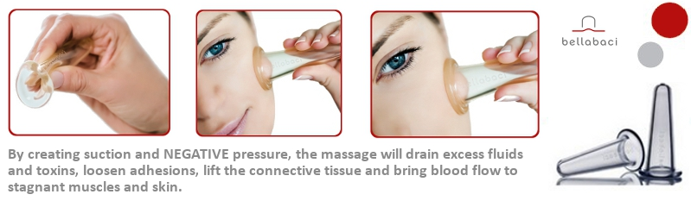

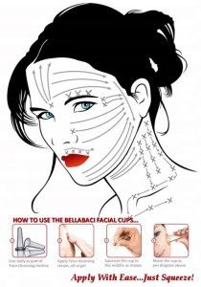
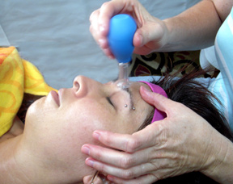
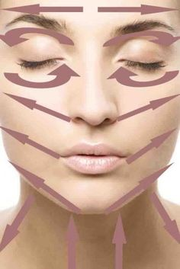

Facial cupping

Slide 27


Types Of Facial Cupping Therapy
Vacuum Facial Cupping A non-surgical procedure for facial rejuvenation and for revitalizing dull skin without the use of botox injections
Massage Cupping loosen and lift connective tissues, increase lymph and blood flow, and release rigid soft tissues. The parasympathetic nervous system is engaged by the pulling action, resulting in deep relaxation that can travel through the entire body

Slide 28

Beauty Benefits of Facial Cupping
The effects brought about by the cupping can have several aesthetic benefits that work on both, dry and oily skin. Here’s how:
Drainage of fluid in the lymph glands results in reduced edema and puffy appearance.
Better nutrition brought to the skin helps bring a young glow to the skin. Any beauty products used post-treatment are absorbed better and are more effective.
The lifting motion reduces the visible fine lines, wrinkles, and scarring because of injuries or acne. The skin also looks plumper. Further, the connecting tissue under facial skin is stimulated so that it heals and reduces smile and laugh lines.
Massaging movements help relax tense facial muscles resulting in a softer, younger appearance.

Slide 29
Therapeutic Benefits
Facial cupping is helpful to patients suffering from a range of ailments related to the head and neck area without the need for more extensive treatments. They are:
Sinus infections or sinusitis
Headaches and migraines
Facial paralysis
Earaches
Conditions in which there is jaw pain and movement of the jaw is hampered, also known as TMJ

Slide 30

Cupping Therapy for Stretch Marks
The skin is stretched and leads to dermal and epidermal tearing. Stretch marks can also form on breasts, hips, upper-arms, buttocks and thighs.
Stretch marks start of red to purple in color. They eventually fade into a pearly white color. The red to purple stage, is the most effective window period for making a difference in the outcome when the marks turn white. Once white, the blood circulation supplying the damaged cells are minimal. So strike while the iron’s RED!
using cup over the stretch marks, It will immediately increase the blood flow. This brings fresh oxygen and nutrients to the area that will help to repair the damage.
More importantly, the deep massage stimulation will nudge fibroblast cells into producing new collagen and elastin. This will decrease the width of the stretch mark. By regularly massaging every day, in the shower or with a repairing oil such as Jojoba, It will increase your results and improve skin tone. Just a few minutes per day will make all the difference!

Slide 31


Cupping Therapy for Scars
Cupping therapy is possibly the best form of deep tissue massage therapy. It is known to work on up to four inches of tissues inside the body.
The suction created by cupping therapy can work to induce the tissues to release the toxins accumulated in them, and also stimulate the lymphatic system. This stimulation helps to clear the released toxins including debris and old blood by carrying them to the surface below the skin. From here, they are naturally expelled by the body.
, the most exciting factor of cupping therapy is that it can work on older scars as effectively as new ones.

Slide 32




Cupping Therapy for Cellulite
Cellulite is a very common issue that this is used for. Its ability to promote the exit of toxins, loosen the dimpling, and stimulate circulation are all very helpful in reducing cellulite
The user simply glides these cups across the target area.
dry cupping is the most common form of therapy used but other forms such as gliding cupping also known as running cupping or massage cupping can also be used.

Slide 33

Cupping Therapy for Acne Vulgaris
Condition which coincides with puberty; believed to be related to hormone levels that occur when secondary sex characteristics are developing.
An inflammatory disorder that affects the sebaceous glands and hair follicles
Severity of the condition varies from minimal to severe

Slide 34

Acne vulgaris
Patients of this group received 3-6 sessions. Of these patients, 7 with nodulocystic acne (64%) showed excellent improvement with disappearance of most lesions.
Of the remaining 4 patients with papulopustular acne, 3 patients (27%) moderately improved and one patient (9%) did not respond to the therapy. The total efficacy rate was 91%

Slide 35

Cupping therapy for breast care
The pumping action lifts and tones the breasts.
It also helps to increase blood flow, eliminating toxins and congestion that can be caused by wearing bras and tight clothing.
The vacuum will enable the breast to drain old congestion and toxins through the lymphatic system, maintain a healthy ph, and get an increased supply of blood and oxygen to the breasts. Healthy breasts are the best defence against cancer

Slide 36

Cupping therapy for Buttock care
It helps to increase blood flow, eliminating toxins and congestion that can be caused by wearing tight clothing.
The vacuum will enable the buttock to drain old congestion and toxins through the lymphatic system, maintain a healthy ph, and get an increased supply of blood and oxygen to the buttocks

Slide 37




Acute Urticaria
There are 4 acuppoints most commonly prescribed for acute urticaria:
LI11 (Quchi),
Sp10 (Xuehai),
Sp6 (Sanyinjiao), and
S36 (Zusanli

Slide 38

Chronic idiopathic urticaria(CIU)
Patients of this group received 2-5 sessions.
From these patients, 9 patients (75%) completely cured with disappearance of episodes over a period of 8 months follow-up after completion of sessions and
3 patients (25%) showed mild improvement in the form of lengthening of the intervals between episodes.

Slide 39
Types of Eczema (Dermatitis)
Allergic contact eczema (dermatitis): a red, itchy, weepy reaction where the skin has come into contact with a substance that the immune system recognizes as foreign, such as poison ivy or certain preservatives in creams and lotions
· Atopic dermatitis: a chronic skin disease characterized by itchy, inflamed skin
· Contact eczema: a localized reaction that includes redness, itching, and burning where the skin has come into contact with an allergen (an allergy-causing substance) or with an irritant such as an acid, a cleaning agent, or other chemical
· Dyshidrotic eczema: irritation of the skin on the palms of hands and soles of the feet characterized by clear, deep blisters that itch and burn
· Neurodermatitis: scaly patches of the skin on the head, lower legs, wrists, or forearms caused by a localized itch (such as an insect bite) that become intensely irritated when scratched
· Nummular eczema: coin-shaped patches of irritated skin-most common on the arms, back, buttocks, and lower legs-that may be crusted, scaling, and extremely itchy
· Seborrheic eczema: yellowish, oily, scaly patches of skin on the scalp, face, and occasionally other parts of the body
· Stasis dermatitis: a skin irritation on the lower legs, generally related to circulatory problems

Slide 40
Atopic dermatitis
The intensity of itch was recorded daily using a modified VAS scale. A reduction in the itch appeared after 30 min of treatment and lasted until the next treatment session. During a 16 months' follow-up only slight eczema occurred and the patient was relieved of her itch. The author suggested that increases in beta-endorphins, ACTH and plasma cortisol may have been the reasons for the improvements.
Cupping is particularly not advised over excoriated, oozing, or infected areas as many eczema patients are colonized with S. aureus

Slide 41
vitiligo
Patients of vitiligo received 3-5 sessions.
some patients show some improvement in response to cupping therapy.

Slide 42




Psoriasis
the treatment of 600 patients suffering from psoriasis
The authors employed a specific regimen involving several modalities such as cupping, electroacupuneture and body acupuncture.
All patients were treated every other day and 30 treatment sessions were sufficient in most cases.
Of the 600 patients, 61.7% were cured,
5.2% were virtually cured,
19.2% were markedly improved,
12.3% were improved and
1.7% were unchanged.
A follow-up study of 100 of these patients recorded a 20% relapse.

Slide 43
Cupping Therapy for Treatment of Cellulitis
Cellulitis is a bacterial inflammatory reaction in the subcutaneous tissues caused mostly by gram positive bacteria as staphylococcus aureus and streptococcus.
multiplication of microorganisms and production of powerful exotoxins by gram positive . In case of presence of associated gram negative bacteremia, powerful endotoxins are released causing endotoxic shock
Main treatment of cellulitis is broad spectrum antibiotics
antibiotics do not affect bacterial toxins..
Antibiotic therapy together with alhijamah was done on the site of maximum inflammation of cellulitis by applying about superficial cuts where blood was drawn out.
An immediate clinical improvement was noted in the form of reduction in all signs of inflammation.
dramatic improvement of cellulitis may be where excretion of interstitial fluids and filtered capillary fluids rich in bacteria and bacterial toxins (CPS) helped in clearing blood from microorganisms and toxins through suction using the negative pressure.
Based on that, cupping therapy did better than antibiotics

Slide 44
Leg Ulcers
the beneficial effects to an increased blood circulation in the affected parts speeding up the healing process.
patients with leg ulcers due to stasis caused by phlebitis and varicose veins , Raynaud's, neuropathy, arteriosclerosis and scleroderma.
Assessment was by means of photographs taken before, during and after treatment.
In all patients the ulcers healed in an acceptable and satisfactory manner.
Interruptions to the treatment were associated with a cessation of the healing process which recommenced only when treatment was resumed.

Slide 45
Warts
Seven patients with warts on the feet and anogenital warts were treated with cupping therapy
The warts disappeared after a short treatment period and untreated warts also disappeared during treatment.
The author claimed that activation of the immune system was the cause of the beneficial effect.

Slide 46


Chloasma
hyperpigmentation condition called melasma (also known as Chloasma Faciei or Mask of Pregnancy). Melasma can be triggered by sun exposure but it’s also seen during and after pregnancy, in women taking estrogen supplements and occasionally related to birth control pills.

Slide 47

post-herpetic neuralgia
Post-herpetic neuralgia is usually a chronic neuropathic pain with a burning character, but some patients experience sharp stabbing pains.
Pain may be constant or intermittent.
Other symptoms and sensory changes may be present in the same dermatome/ nerve distribution as the pain:
Itch
Anaesthesia (numbness)
Hyperasthesia (sensitivity to touch)
Allodynia (pain from a light touch)
Other sensory change such as reaction to temperature.
Motor dysfunction (this is rare):
Autonomic dysfunction (eg sweating)
Organ damage (eg blindness if there is ophthalmic involvement)
Chronic pain can lead to insomnia, anxiety and depression.
The duration of post-herpetic neuralgia is variable.
symptoms resolve within 6 months to 1 year.
In untreated patients, about half have no pain at 6 months.
Some people have pain lasting for many years, sometimes several decades.
The duration and severity of neuralgia increases with age.
around the skin lesion
into the tenderness spots
cupping therapy appears to be effective for post-herpetic neuralgia

Slide 48




Hair Loss
performing dry cupping on the scalp, the suction can help open the follicles and promote blood circulation to help maintain the hair. This theory only applies to follicles that are still alive.
Wet cupping on the head can also be effective as it will get rid of many harmful toxins and pathogens that build up underneath the scalp.
Obviously healthy diet and nutrition is vital for the follicle to stay alive and maintain a healthy growth.
Individuals who wish to perform dry or wet cupping on their head must shave of their hair for easy suction.

Slide 49


Is 'cupping' a miracle cure or the silliest celebrity health fad ever?

Slide 50



Pictures of athletes from the Olympics

